Slide 1






State Management
Cookies, Sessions, Bootstrap
State Management
SoftUni Team
Technical Trainers
Software University
http://softuni.bg

Slide 2


Table of Contents
Bootstrap
Cookies
Sessions

Slide 3
Have a Question?
sli.do #JavaWeb

Slide 4

Bootstrap

Slide 5

What is a Responsive Design?
Presentation layers that adjust according to the screen size of the different devices
Desktop layouts
Tablet layouts
Mobile layouts

Slide 6
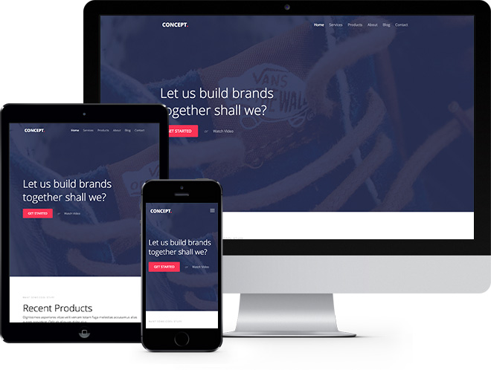
Bootstrap
Free front-end framework that provides capabilities to ensure responsive design

Slide 7
Bootstrap Import Option 1
<link rel="stylesheet" href="https://maxcdn.bootstrapcdn.com/bootstrap/3.3.7/css/bootstrap.min.css"/>
<script src="https://ajax.googleapis.com/ajax/libs/jquery/3.1.1/jquery.min.js"/>
<script src="https://maxcdn.bootstrapcdn.com/bootstrap/3.3.7/js/bootstrap.min.js"/>

Slide 8
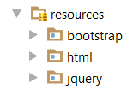
Bootstrap Import Option 2
<link rel='stylesheet' href='../bootstrap/css/bootstrap.min.css'/>
<script src="../jquery/jquery.min.js"></script>
<script src="../bootstrap/js/bootstrap.min.js"></script>

Slide 9
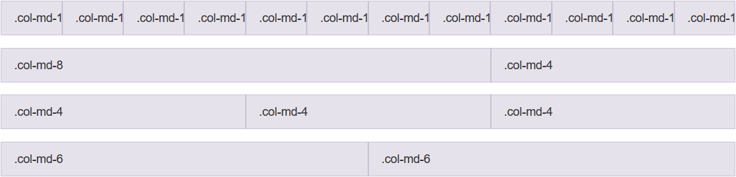
Grid System
Bootstrap includes a responsive, mobile first fluid grid system that appropriately scales up to 12 columns
Col 1
Col 2
Col 12
Row 1
Row 2
Row 3
Row 4

Slide 10
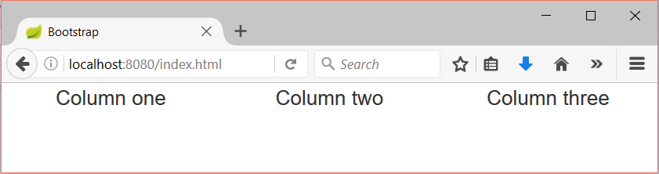
Grid System Demo
index.html
index.css
…
<div class="container-fluid">
<div class="row">
<div class="col-sm-4">Column one</div>
<div class="col-sm-4">Column two</div>
<div class="col-sm-4">Column three</div>
</div>
</div>
…
div {
text-align: center;
}
Container
Row
Columns

Slide 11
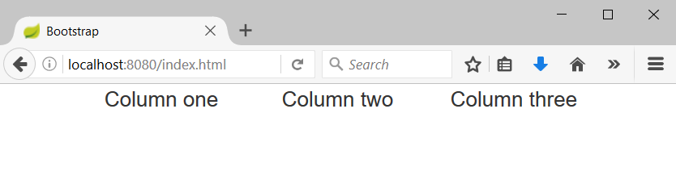
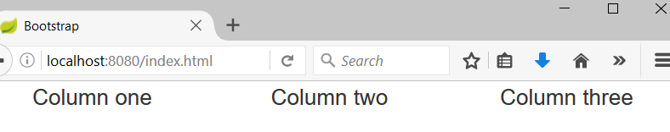
Containers
Rows must be placed in containers
.container is fixed-width
.container-fluid is full-width
Leaves margin
Full width, no margins

Slide 12
Column Classes
Determines how many columns to use on different screen sizes
.col-xs: Width Less than 768px
.col-sm: Width Between 768px and 992px
.col-md: Width Between 992px and 1200px
.col-lg: Width Over 120px
index.html
<div class="col-sm-8 col-lg-4">Column one</div>
<div class="col-sm-2 col-lg-4">Column two</div>
<div class="col-sm-2 col-lg-4">Column three</div>

Slide 13
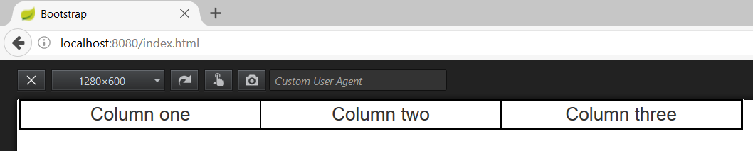
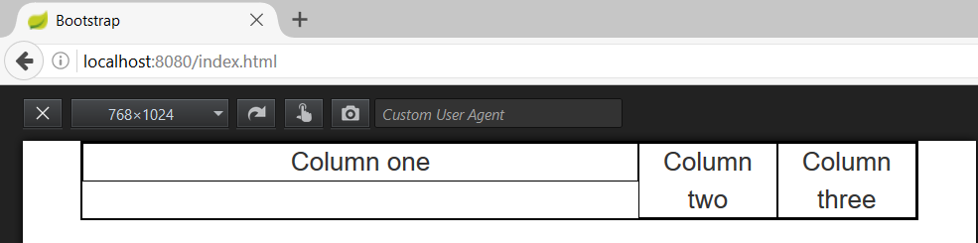
Column Classes (2)
index.html
<div class="col-sm-8 col-lg-4">Column one</div>
<div class="col-sm-2 col-lg-4">Column two</div>
<div class="col-sm-2 col-lg-4">Column three</div>
Width 1280px
Width 768px

Slide 14
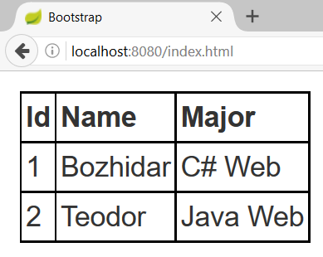
HTML Table
index.html
index.css
<table>
<tr>
<th>Id</th>
<th>Name</th>
<th>Major</th>
</tr>
<tr>
<td>1</td>
<td>Bozhidar</td>
<td>C# Web</td>
</tr>
…
</table>
table {
margin: 10px;
}
table, th, td {
border: 1px
solid
black;
border-collapse: collapse;
padding: 2px;
}
Table row
Table header
Table data

Slide 15
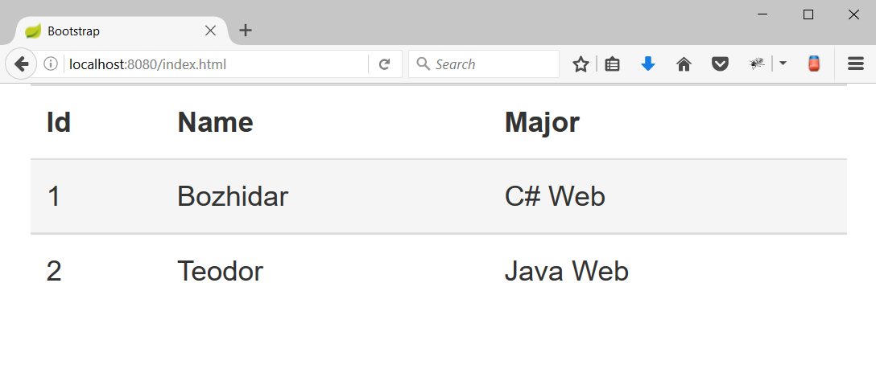
HTML Table with Bootstrap
Hover effect
index.html
<table class="table table-hover">
<tr>
<th>Id</th>
<th>Name</th>
<th>Major</th>
</tr>
<tr>
<td>1</td>
<td>Bozhidar</td>
<td>C# Web</td>
</tr>
…
</table>
Bootstrap table

Slide 16
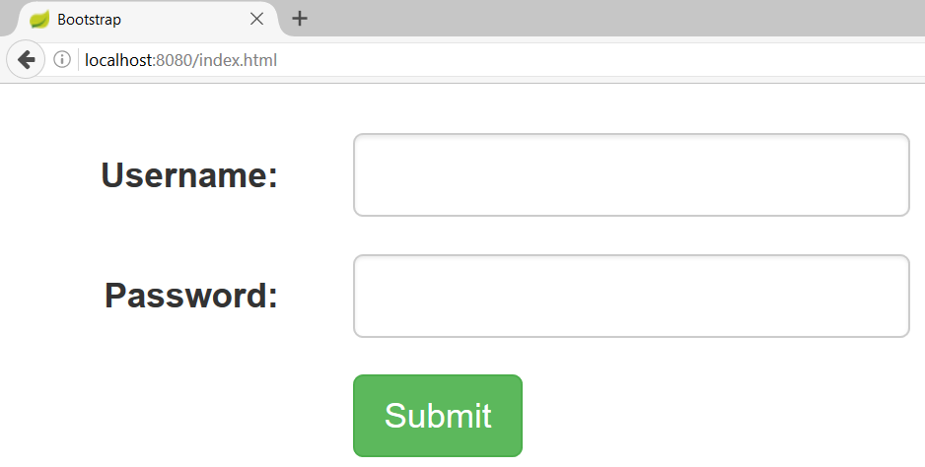
Form with Bootstrap
index.html
<form class="form-horizontal">
<div class="form-group">
<label class="control-label col-sm-2">Username:</label>
<div class="col-sm-4">
<input class="form-control" type="text"/>
</div>
</div> …
</form>

Slide 17
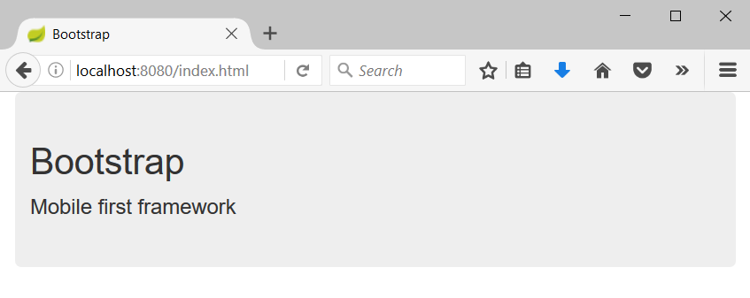
Jumbotron
Big box that provides information
index.html
<div class="container">
<div class="jumbotron">
<h1>Bootstrap</h1>
<p>Mobile first framework</p>
</div>
</div>

Slide 18
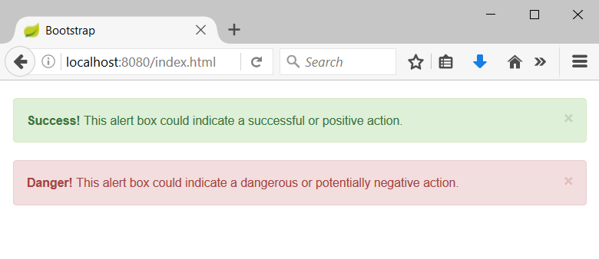
Alerts
Provide information about the outcome of an event
index.html
<div class="alert alert-success alert-dismissable">
<a class="close" data-dismiss="alert" aria-label="close">×</a>
<strong>Success!</strong> This alert box could indicate a successful or positive action.
</div>
…

Slide 19

Cookies

Slide 20


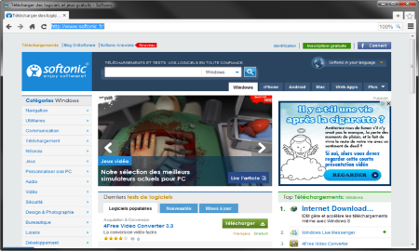



HTTP is Stateless
it doesn’t store information about the requests
Web Client
Web Application
GET
POST
GET
Not stored

Slide 21
What are Cookies?
A small file that web applications embeds on the user's computer
http://www.oracle.com/
Web Client
Web Application
GET www.example.bg HTTP/1.1
HTTP/1.1 200 OK Set-Cookie: lang=en
GET www.example.bg HTTP/1.1 Cookie: lang=en

Slide 22
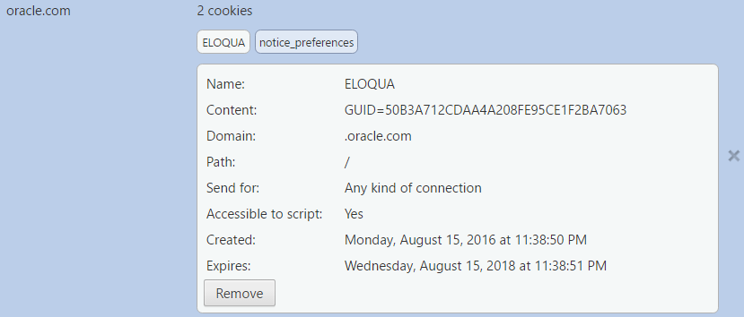
Cookie Example
Name
Value
Host
Is secured?
HTTP only
Created on
Expires on

Slide 23




Cookie Purpose
Cookie
Language settings
Preferences (Remember sign in)
Store
Session

Slide 24
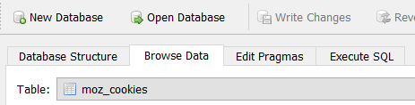
Examine your Cookies
Most cookies are stored in a RDBMS, usually SQLite
Download SQLite browser from here
In Mozilla cookies are located here:
Open the file with the sqlite browser
C:\Users\{username}\AppData\Roaming\Mozilla\Firefox\Profiles\2awcekaj.default\cookies.sqlite

Slide 25
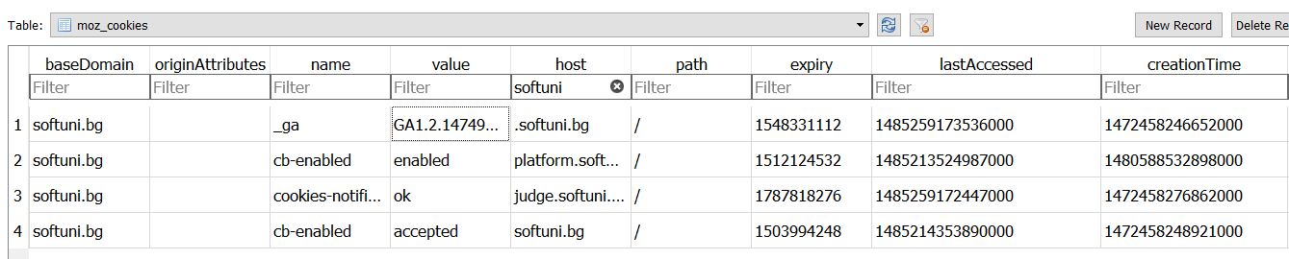
Examine your Cookies (2)
Name
Host
Created on
Value
Last accessed on

Slide 26

Third Party Cookies
Cookies stored by an external party
http://stackoverflow.com/
Web Application
Web Client
Cookie transfer
Cookie transfer
Third Party

Slide 27
Custom-made Cookie
HTTP Variable
invoker.cgi
java com.cgi.Main $HTTP_COOKIE
Main.java
Command-line arguments
private static void getCookie(String[] args){
String cookieString = args[0];
StringTokenizer pairs = new StringTokenizer(cookieString, "; ");
while(pairs.hasMoreTokens()){
String pair = pairs.nextToken();
StringTokenizer cookie = new StringTokenizer(pair, "=");
String key = cookie.nextToken();
String value = cookie.nextToken(); }
}

Slide 28
Cookie Exercise
Live Exercises in Class (Lab)

Slide 29

Sessions

Slide 30

What are Sessions?
A session is a way to store information to be used across multiple pages
/login
Web Application
Session
/home
user: Teo
/products

Slide 31
Relation with Cookies
Session Store
sid 5 { uid: 101 }
sid 7 { uid: 102 }
Cookie {
name: sid value: 5
}
Validate
Req
Web Application
Session
Resp
Database
Cookie {
name: sid value: 7
}
Req
Get data
uid name 101 Teo
102 Bojo
Resp
Create personal web page

Slide 32
Custom-made Session
Session.java
public class Session {
private long id;
private Map<String, String> pairs;
private Date createdOn;
private Date expiresOn;
}
Unique id
Key-value pairs
Creation date
Expiration date

Slide 33
Create your own Sessions
Live Exercises in Class (Lab)

Slide 34

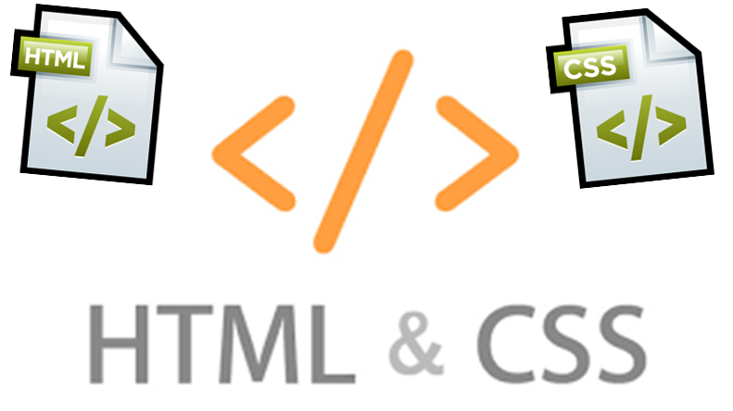
Summary
Bootstrap provides an easy way to create responsive design that fits on all screens
Cookies are client based stored information
They are created by web applications
Browser sends them back to the application
Sessions are server based information that is used across multiple pages

Slide 35








Web Development Basics – Course Overview
https://softuni.bg/courses/

Slide 36
License
This course (slides, examples, demos, videos, homework, etc.) is licensed under the "Creative Commons Attribution-NonCommercial-ShareAlike 4.0 International" license

Slide 37






Free Trainings @ Software University
Software University Foundation – softuni.org
Software University – High-Quality Education, Profession and Job for Software Developers
softuni.bg
Software University @ Facebook
facebook.com/SoftwareUniversity
Software University @ YouTube
youtube.com/SoftwareUniversity
Software University Forums – forum.softuni.bg

